Slide 2
CSE 280
14.1 - 14.3
14.4 - 14.6

Slide 3
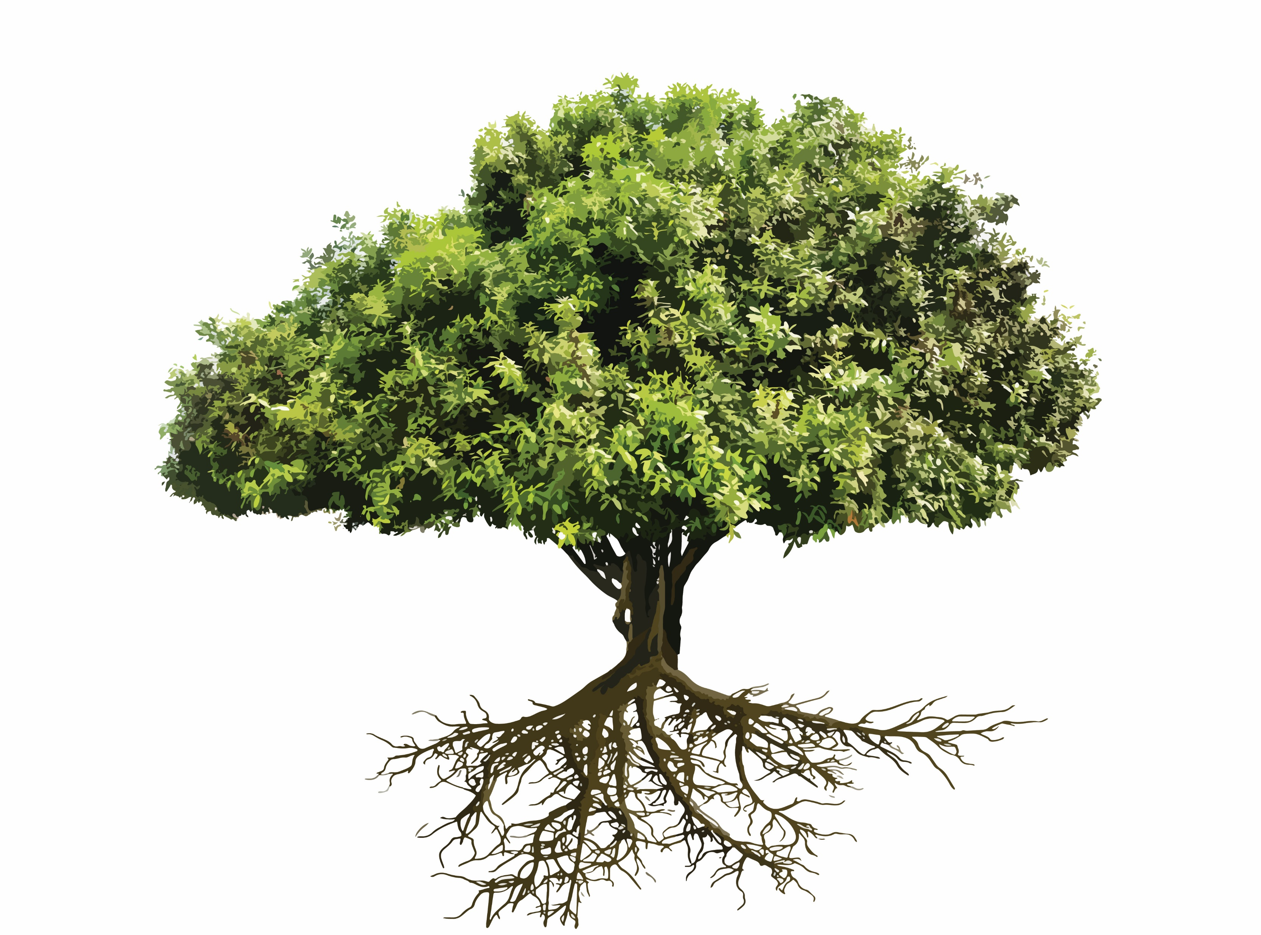
Trees
CSE 280
14.1 - 14.3
14.4 - 14.6

Slide 4
Basic
Huffman Trees
Tree Traversal
Spanning Tree

Slide 5
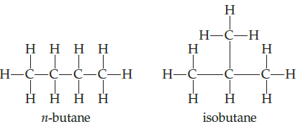
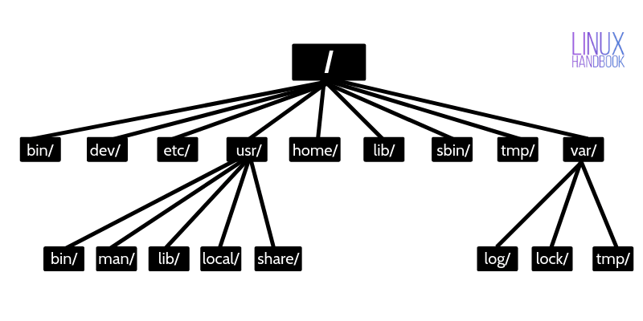
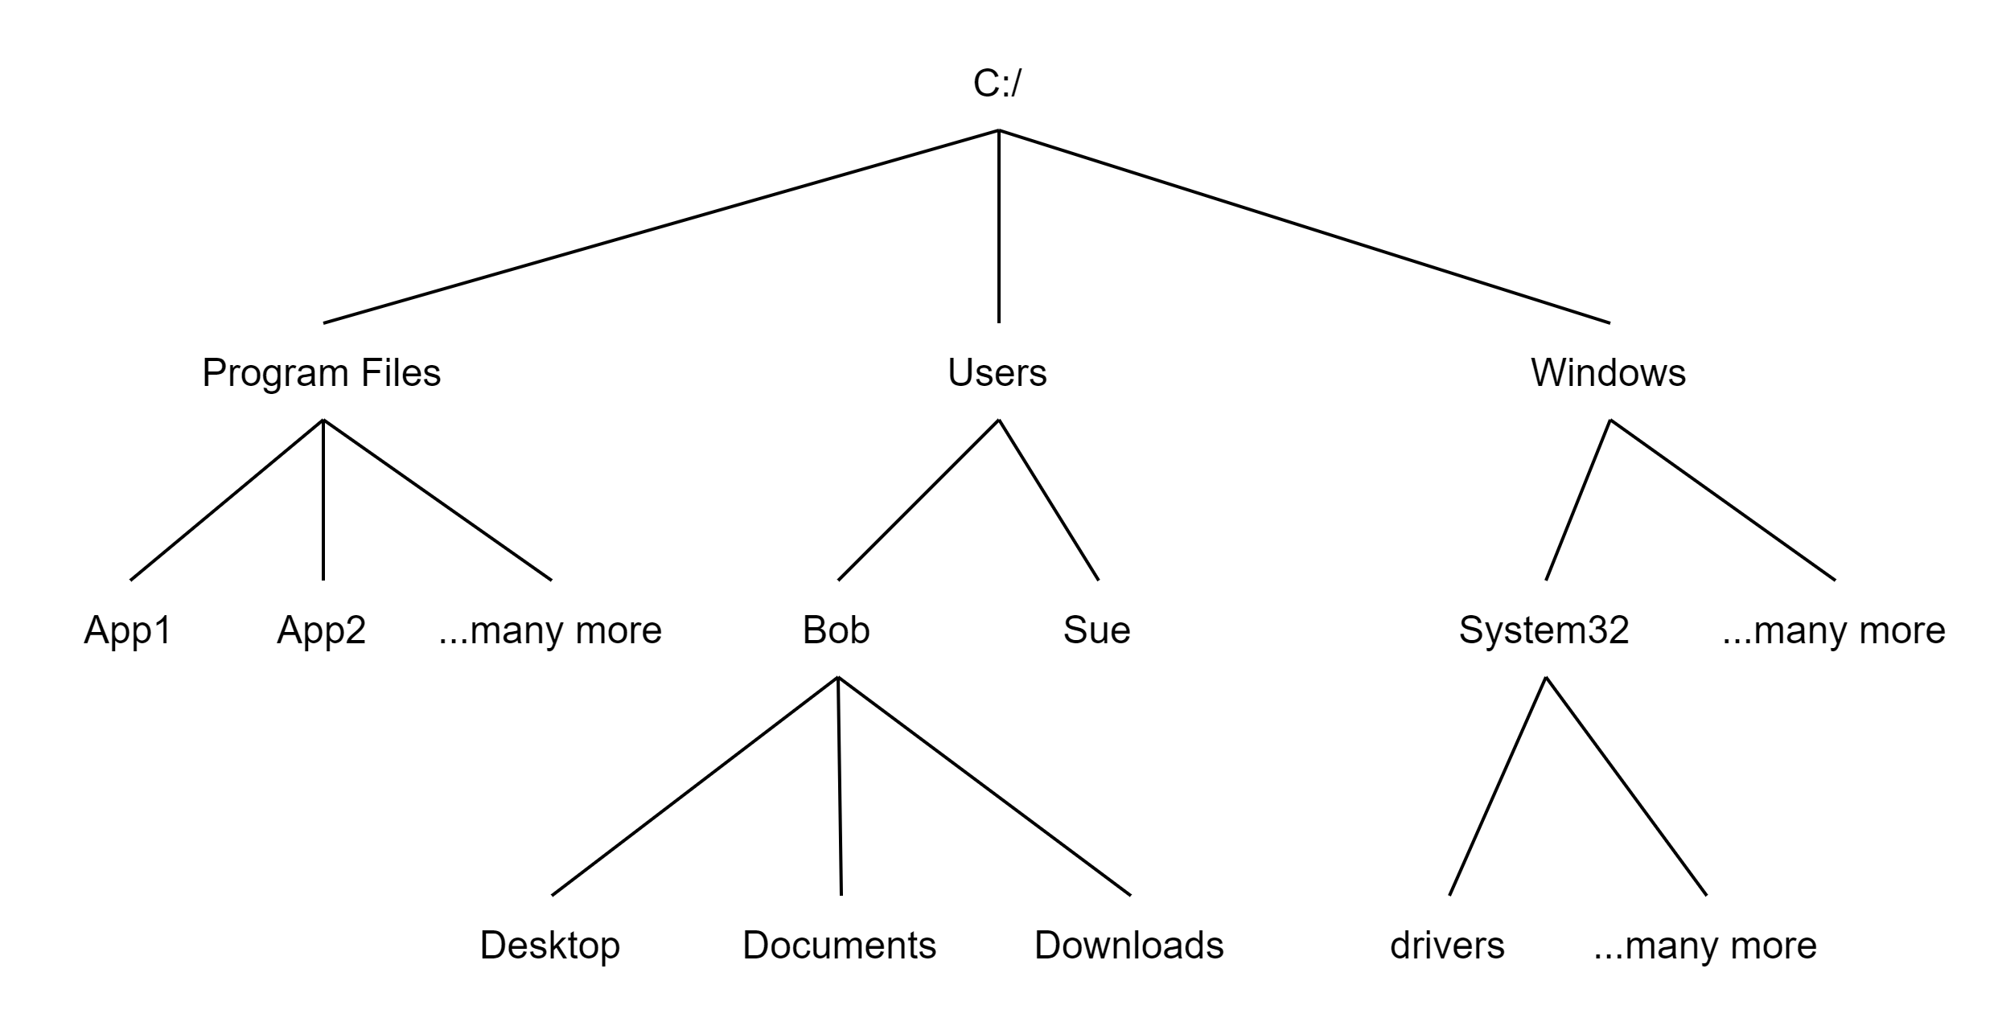
Background
Arthur Cayley, English mathematician, discovered trees in 1857 when he needed a way to count chemical compounds
Fast Searching
Data compression
Modeling games/procedures/decisions/relationships
Filesystem hierarch
Evaluating mathematical expressions
Neff, Rick, and Gopalakrishnan, Ganesh. First Three Odds Double Halve Divide Reciprocate. CRC Press, 2021
Rosen, Kenneth. Discrete Mathematics and Its Applications, 7th Edition. McGraw-Hill, 2012

Slide 6
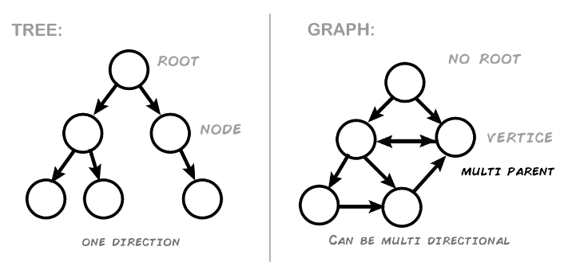
Trees vs Graphs
Both are composed of vertices and edges
Tree: Only one path from one vertex to any other vertex
Graph: More than one path between vertices
Graphic from: https://medium.com/swlh/making-data-trees-in-python-3a3ceb050cfd

Slide 7
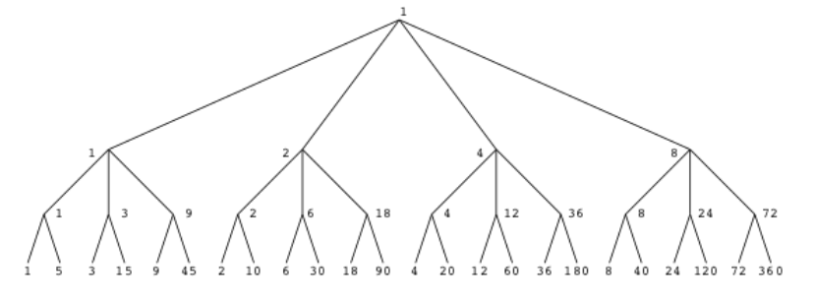


$m$-ary Tree
The number of edges leaving each node is the branching factor. We can call this number $m$.
Full tree: All internal nodes have exactly $m$ edges
When $m$ is 2, we call it a binary tree
What is the $m$ of this tree?
What is the height $h$ of this tree?

Slide 8
Tree Terminology
Free Tree
Rooted Tree
Root
Level
Height
Parent
Child
Ancestor
Descendant
Leaf
Internal vertex
Sibling
Subtree
f
a
c
b
a
e
g
b
e
c
d
f
g
d
e
f
g

Slide 9
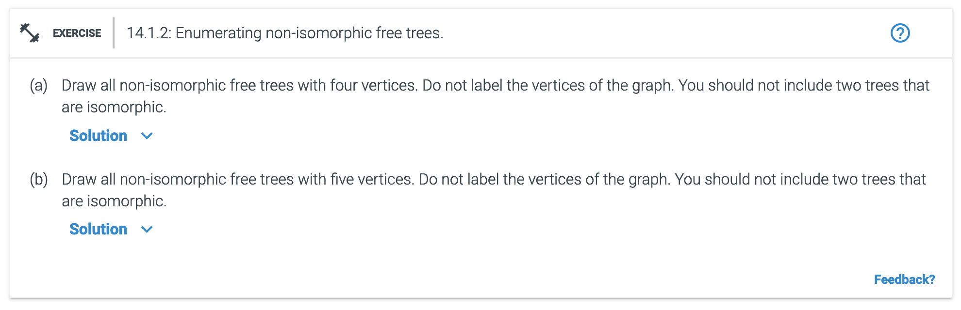
Review:
What does it mean if two graphs are isomorphic?
Additional Exercises:
14.1.2

Slide 10
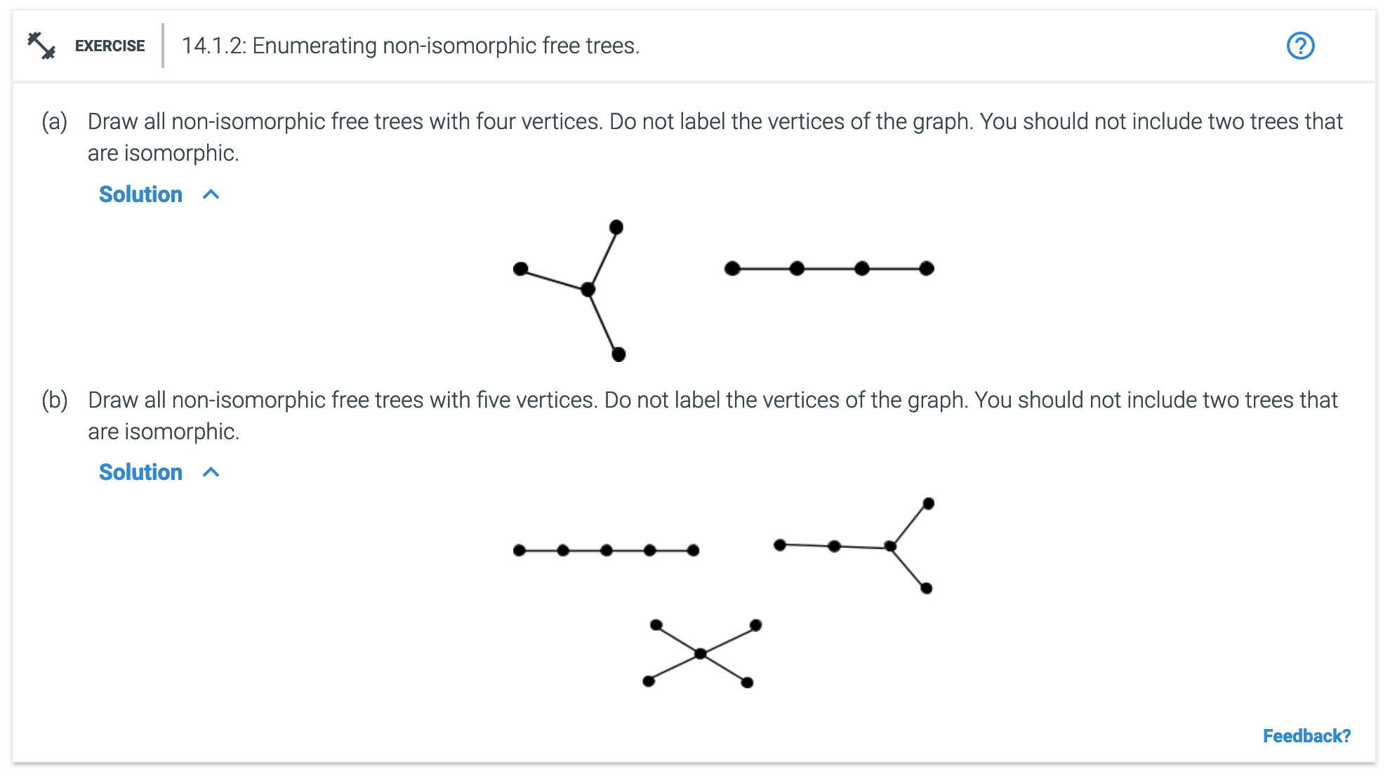
Review:
What does it mean if two graphs are isomorphic?
Additional Exercises:
14.1.2

Slide 11

Properties of trees
There is exactly one way to travel between every pair of vertices by a path.
Trees always have 1 more vertex than edges. Let $T$ be a tree with $n$ vertices and $m$ edges, then:
$n=m+1$
$m=n −1$
Binary Trees have two edges from each vertex.
A full binary tree with $n$ leaves has $2n−1$ vertices.
A full binary tree with $i$ internal vertices has $n=2i+1$ vertices
The maximum number of vertices at level $l$ of an $m$-ary tree is $m^{l}$ (for a binary tree it is $2^{l}$)
If the height of a tree is $h$, then it has at most $m^{h}$ leaves (for a binary tree, $2^{h}$)

Slide 12
A Few Tree Applications
Binary Search Trees
Fast searching. Optimize time.
Huffman Trees
Data compression. Optimize space.
Binary tree, but not a binary search tree.
Used to create an optimal prefix code
Game trees
Mathematical expressions

Slide 14
Basic
Huffman Trees
Tree Traversal
Spanning Tree

Slide 15
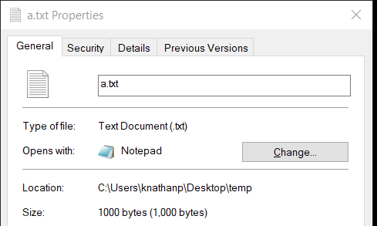
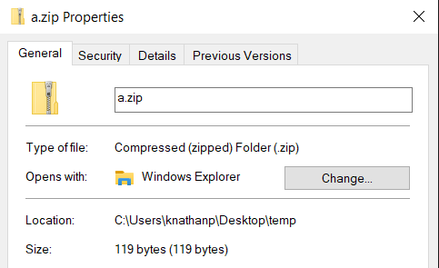
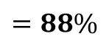

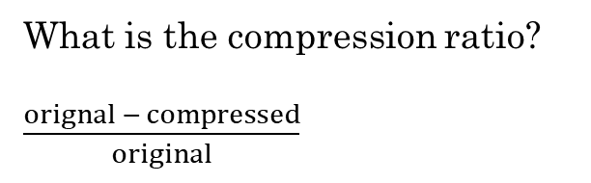
Consider a text file that consists of 1000 a's.
aaaaaaaaaaaaaaaaaaaaaaaaaaaaa
aaaaaaaaaaaaaaaaaaaaaaaaaaaaa
aaaaaaaaaaaaaaaaaaaaaaaaaaaaa
...
How much space would it take to store this file if we use standard ASCII or UTF-8, which each use 1-byte (8-bits) to store the letter "a"?
ZIP compression
Can you think of a way to store this file in a way that would save space?
What is the compression ratio?
$\frac{orignal − compressed}{original}$
$$\frac{1000 −119 }{1000}=0.88$$
$$=88\%$$

Slide 16
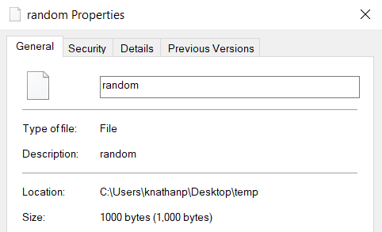
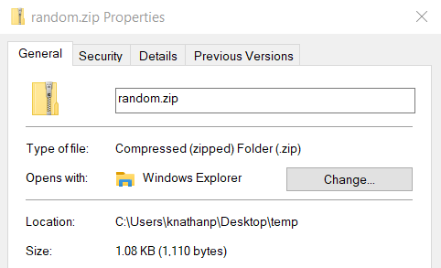
What about a file that consists of 1000 completely random bytes?
q2KVZRbqRiflgI56Es4plUeWoWBkw2b892Ss5JWSJAk5SPaIksHucUoGFMszZ2pqBB
...
Can you think of a way to store this file in a way that would save space?
ZIP compression
Why don't we save any space by compressing it?

Slide 17

Fixed-length Encoding
Encode means "represent"
A | 0000 | 0
B | 0001 | 1
C | 0010 | 2
D | 0011 | 3
... | ...
O | 1110 | 14
P | 1111 | 15
Q | ? | ?
R | ? | ?
S | ? | ?
T | ? | ?
... | ? | ?
How many bits would it take to encode the letters of the English alphabet? (the minimum number of bits)
There are 26 letters
4 bits ($2^{4}$) will only give 16 possible encodings
Need at least 5 bits
But that gives $2^{5}=32$ different possibilities. Waste of bits
There are six combinations of bits that are unused
This is a fixed-length encoding. Each symbol/letter uses five bits.
Wastes space and time.
Can we find a coding scheme that uses fewer bits?
A | 00000 | 0
B | 00001 | 1
C | 00010 | 2
D | 00011 | 3
... | ...
Z | 11001 | 25
Unused | 11010 | 26
Unused | 11011 | 27
Unused | 11100 | 28
Unused | 11101 | 29
Unused | 11110 | 30
Unused | 11111 | 31
Rosen, Kenneth. Discrete Mathematics and Its Applications, 7th Edition. McGraw-Hill, 2012

Slide 18
Variable-length Encoding
Instead of using a fixed number of bits to represent each letter/symbol, we can use bit strings of different lengths to encode letters.
For efficiency, letters that occur more frequently should be represented using shorter bit strings. Letters that are rarely used should be represented using longer bit strings.
Example:
The letters e, a, t are more common than x and z.
What if we represent the letter e with 0, a with 1, and t with 01?
Then the bit string 0101 could represent eat, tea, eaea, or tt.
e | 0
a | 1
t | 01
Rosen, Kenneth. Discrete Mathematics and Its Applications, 7th Edition. McGraw-Hill, 2012

Slide 19
Prefix Codes
One way to make sure no bit string corresponds to more than one sequence of letters is to encode letters in such a way that the bit string for a letter never occurs as the first part of a bit string for another letter.
This is called a Prefix Code.
Example
To represent the letters e, a, t using a prefix code, we could choose 0 for e, 10 for a, and 11 for t.
The bitstring 10110 represents the word ate. There is no other possible interpretation.
Now we can decode or recover a word from a bitstring without ambiguity.
e | 0
a | 10
t | 11
Rosen, Kenneth. Discrete Mathematics and Its Applications, 7th Edition. McGraw-Hill, 2012

Slide 20
Prefix Codes
e | 0
a | 10
t | 110
n | 1110
s | 1111
A prefix code can be represented using a binary tree.
Leaves represent the characters/symbols we need to represent
Edges represent the encoding bits. A left edge is a 0 and a right edge is a 1.
The bit string used to encode a symbol is the sequence of edges to reach the symbol.
Because this is a tree, the path to get to any leaf is unique.
The sequence of bits formed by the path is a prefix code.
0
1
e
0
1
a
0
1
11111011100
t
0
1
S A N E
n
s
Rosen, Kenneth. Discrete Mathematics and Its Applications, 7th Edition. McGraw-Hill, 2012

Slide 21
Prefix Code Examples
Huffman codes
Country calling codes
ISBN country and publisher assignments
Machine language instruction sets

Slide 22
Where is Huffman Coding used?
JPEG
MP3
DEFLATE algorithm (Huffman Coding is combined with LZ77 compression)
zip, gzip, 7-Zip, C zlib library, PuTTY, ...
PNG files

Slide 23
Huffman Trees
Used to produce a Huffman Coding, which is a prefix code.
It is not only a prefix code, but it is a prefix code using the fewest number of bits possible.
Fundamental algorithm in data compression.
Uses a binary tree.
Store more frequently seen symbols closer to root.
Label the links rather than the nodes. Left link is 0, right link is 1.
Symbols we want to represent are stored at the leaves.
Each symbol is encoded into a unique bitstring by following the structure of the tree.
0
1
e
0
1
a
0
1
t
0
1
n
s

Slide 24

Compression Ratio
How do we know how much space/time we are saving by using a variable-length encoding instead of a fixed-length encoding?
Calculate the compression ratio!
Compression Ratio
$f$: bits per symbol for fixed length encoding
$v$: average bits per symbol with variable length encoding
$\frac{f−v}{f}⋅100$
v = encoded/(fixedbits/numbits)

Slide 25
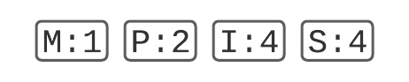
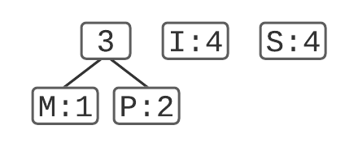
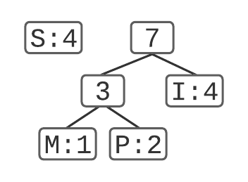
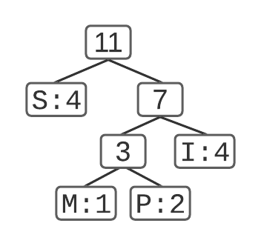
Example: Create a Huffman Tree for the string "MISSISSIPPI"
1. List out the counts
2. Go through the algorithm:
1. List symbols in a priority queue sorted by count (smallest count first)
2. Combine first two symbols (M and P) into a tree and add to the proper place in the queue
3. Repeat again, combining first two items in queue into a tree (M, P, and I) and adding back to the queue.
4. Continue to repeat until only one item is on the queue. This is the completed tree.
3. Extract the encoding for each letter:
100110011001110110111 21 bits
Letter | Count
M | 1
P | 2
I | 4
S | 4
Letter | encoding
M | 100
P | 101
I | 11
S | 0
M I SSI SSI P P I

Slide 26



Example: Create a Huffman Tree for the string "MISSISSIPPI"
Calculate the compression ratio.
How many bits per letter would it take for a fixed-length encoding?
2 bits per letter
0010111110111110010110 22 bits
How many bits on average with this Huffman encoding?
M: 3 bits * 1 letter = 3
P: 3 bits * 2 letters = 6
I: 2 bits * 4 letters = 8
S: 1 bits * 4 letters = 4
Total: 3+6+8+4 = 21
Average bits per letter: 21/11 = 1.91
Letter | Count
M | 1
P | 2
I | 4
S | 4
total | 11
Letter | encoding
M | 00
P | 01
I | 10
S | 11
M I S S I S S I P P I
Letter | encoding
M | 100
P | 101
I | 11
S | 0
Compression ratio:
$\frac{f−v}{f}⋅100$
$f=2$
$v=1.91$
$$\frac{2−1.91}{2}⋅100=4.5\%$$
v = encoded/(fixedbits/numbits)

Slide 27
Example: Create a Huffman Tree for the string "MISSISSIPPI"
Letter | fixed | variable
M | 00 | 100
P | 01 | 101
I | 10 | 11
S | 11 | 0
0010111110111110010110
Fixed
M I S S I S S I P P I
100110011001110110111
Variable
M I SSI SSI P P I

Slide 28
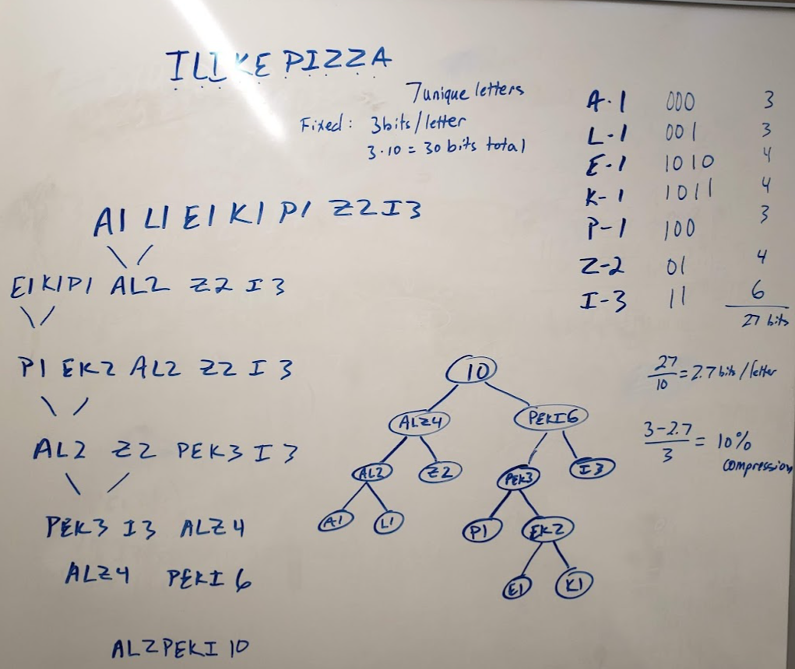

Try it:
Create a Huffman tree and encoding for "I LIKE PIZZA"
How many bits per letter for fixed encoding?
How many bits per letter for Huffman?
Compression: 10%
3
2.7
$$\frac{3−2.7}{3}=10\%$$

Slide 29
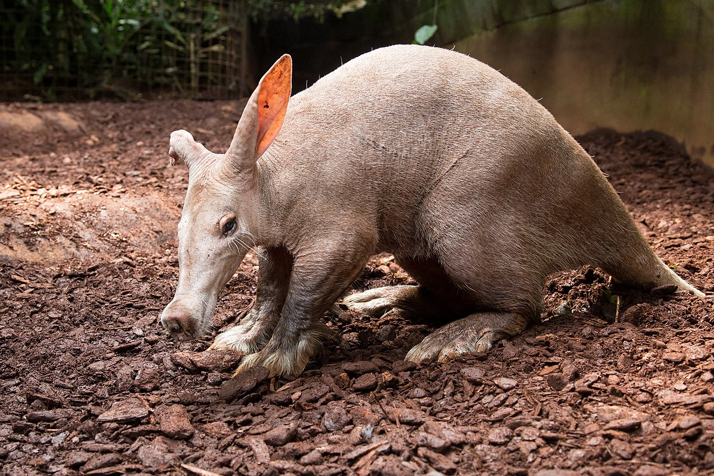
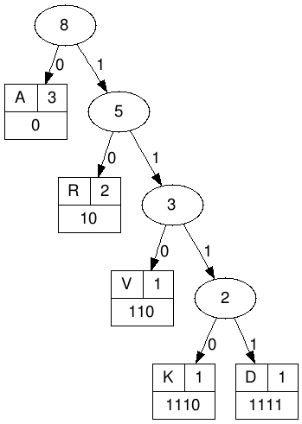

Try it:
Create a Huffman tree and Huffman encoding for "AARDVARK"
 | count
D | 1
K | 1
V | 1
R | 2
A | 3
fixed
000
001
010
011
100
101 110 111
encoding
1111
1110
110
10
0
001011111100101110
AAR D V AR K
How many bits for fixed length encoding?
How many bits for variable length encoding?
Compression ratio?
Compression ratio:
$\frac{f−v}{f}⋅100$ , v = encoded/(fixedbits/numbits)

Slide 30
Additional Exercises
14.2.2
14.2.3

Slide 31
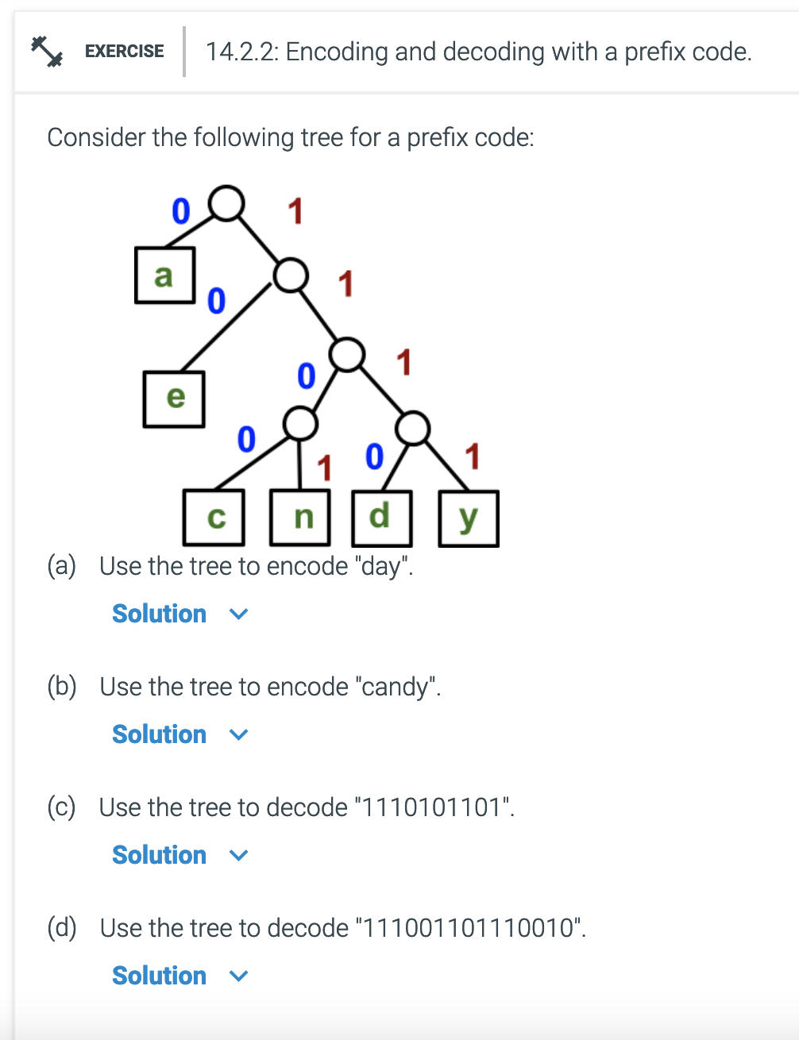
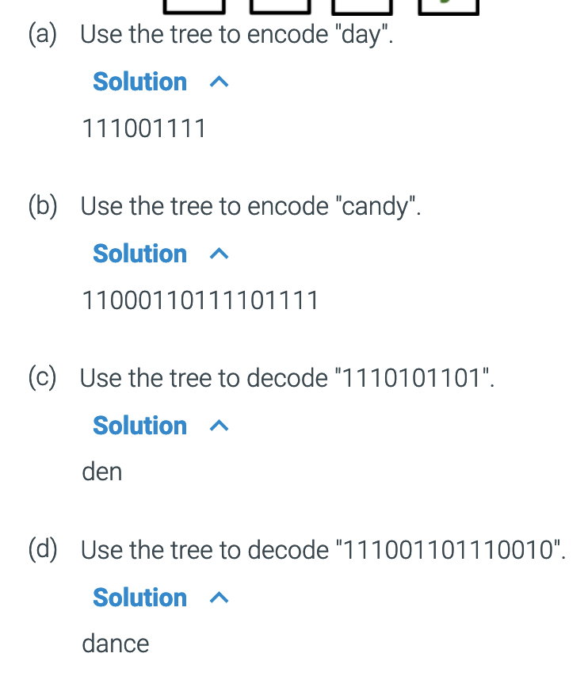
Additional Exercises
14.2.2
14.2.3

Slide 32
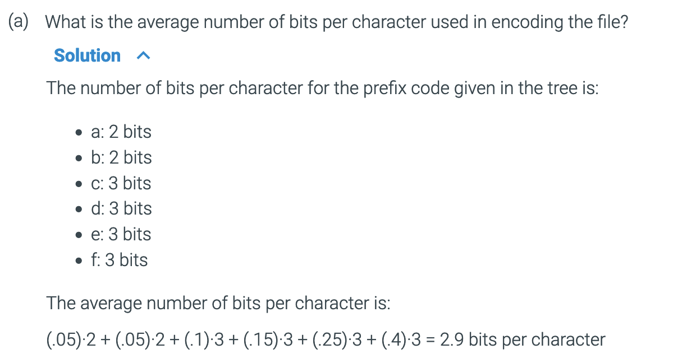
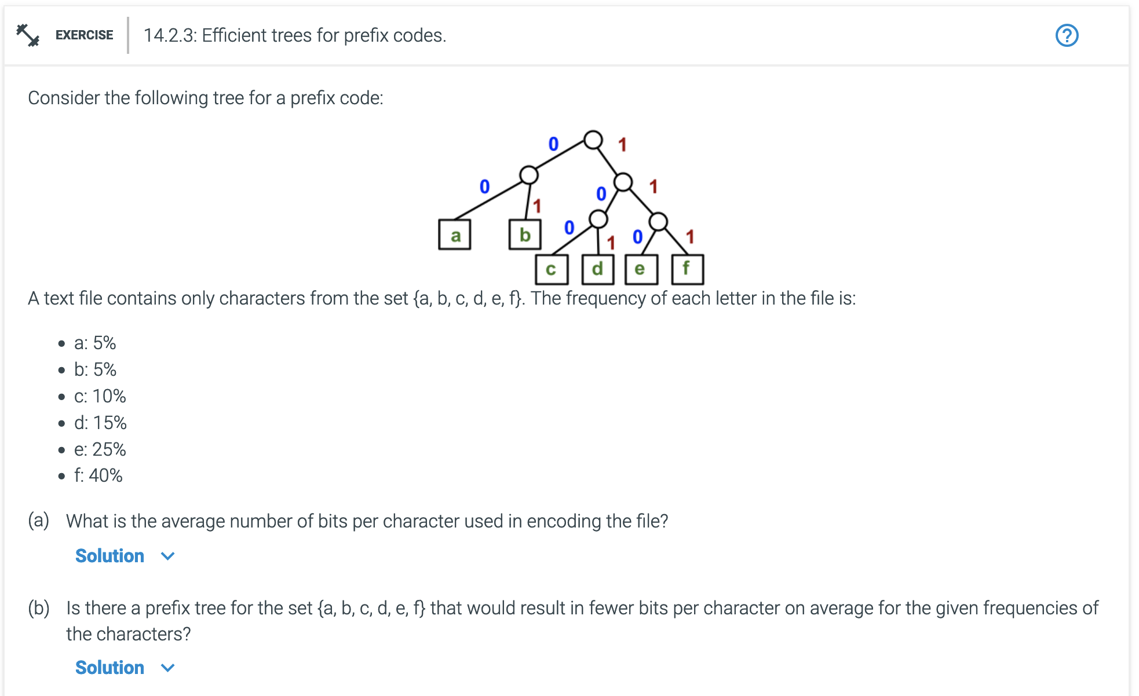
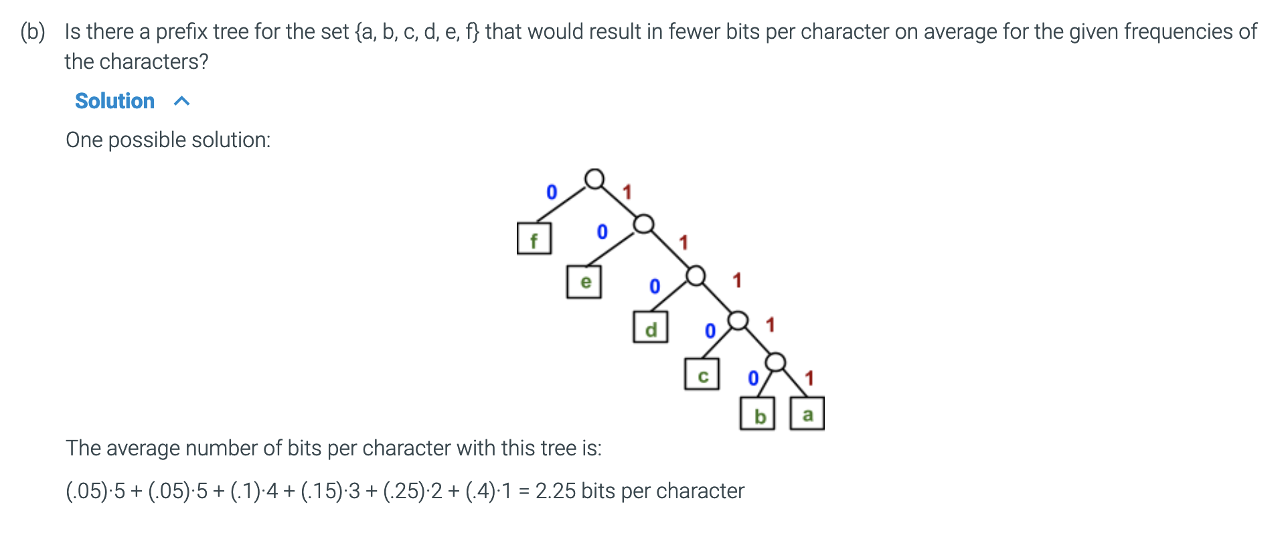
Additional Exercises
14.2.2
14.2.3

Slide 33
Python Dictionary
Represent a node using a Python dictionary
['name': 'a', 'weight': 3, 'left-child': None, 'right-child': None]
['name': 'dk',
'weight': 2,
'left-child': ['name': 'd',
'weight': 1,
'left-child': None,
'right-child': None],
'right-child': ['name': 'k',
'weight': 1,
'left-child': None,
'right-child': None]
]

Slide 34
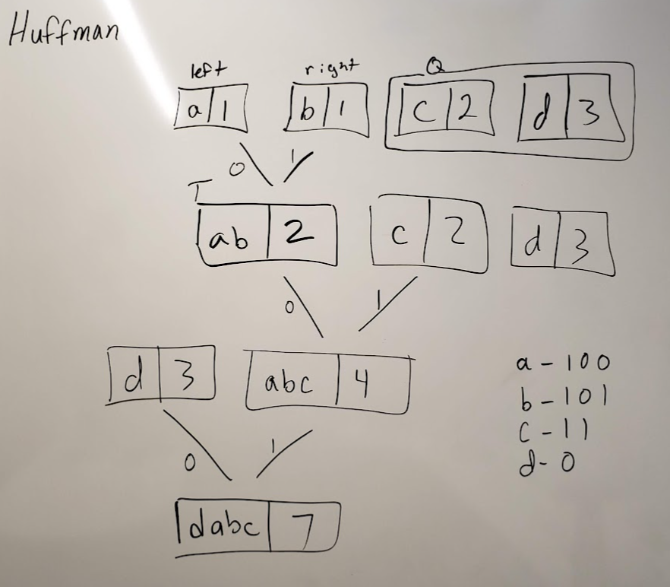
Huffman algorithm
def make_Huffman_tree(Q):
# while Q has more than 1 element
while len(Q) > 1:
# get the first two items in Q, then delete them from Q
Tl = Q[0]
Q = Q[1:]
Tr = Q[0]
Q = Q[1:]
# create a new tree T with Tl and Tr as its
# left and right subtrees, and weight equal to the
# sum of Tl's and Tr's weights.
T = make_tree(Tl, Tr)
# insert T into Q in the proper place based on its weight
insert_tree(T, Q)
# Q[0] now contains T
return T # The same as Q[0]. The only remaining item in Q

Slide 35
Huffman Practical Application
Python Example implementing Huffman Tree

Slide 36
2

Slide 37
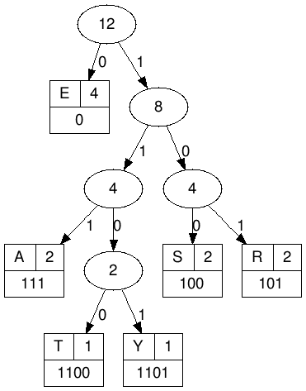

Try it:
Given this Huffman Tree, decode this bitstring:
110010100100111101001111001101
T R EES A R EEA S Y
TREESAREEASY
What is the compression ratio?
fixed: 6 characters = 3 bits/character. Total of 3*12 = 36 bits
variable: 1*4 + 1*4 + 2*3 + 2*3 + 2*3 + 4*1 = 30 bits
$\frac{\left(36 −30\right)}{36} ∗100=16.67\%$

Slide 38
Basic
Huffman Trees
Building a tree
Tree Traversal
Searching a tree
Spanning Tree
Changing Graphs to trees

Slide 39
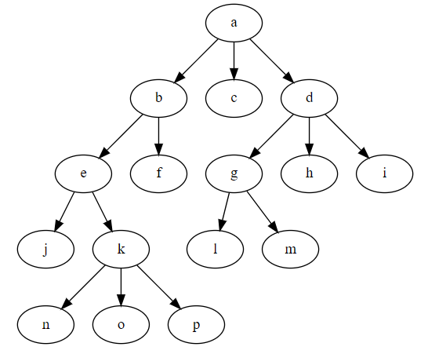
Tree Traversal
Preorder
Inorder
Postorder
Rosen, Kenneth. Discrete Mathematics and Its Applications, 7th Edition. McGraw-Hill, 2012

Slide 40

Preorder
If the tree consists only of a root vertex $r$, then $r$ is the preorder traversal of the tree.
Otherwise, visit $r$. Then visit each subtree of $r$ starting at the left and do a preorder traversal.
What is the preorder traversal of this tree?
$a,b,e,j,k,n,o,p,f,c,d,g,l,m,h,i$
Preorder: Visit root, then visit subtrees left to right
Rosen, Kenneth. Discrete Mathematics and Its Applications, 7th Edition. McGraw-Hill, 2012

Slide 41
Preorder
Preorder: Visit root, then visit subtrees left to right
What is the preorder traversal of this tree?
* + 1 2 * 5 6
Preorder traversal of a tree representing an expression produces prefix or Polish notation.
This is also how functions in most programming languages work. For example:
add(1, 2)
*
+
*
1
2
5
6
Rosen, Kenneth. Discrete Mathematics and Its Applications, 7th Edition. McGraw-Hill, 2012

Slide 42

Postorder
If the tree consists only of a root vertex $r$, then $r$ is the postorder traversal of the tree.
Otherwise, traverse the subtrees in order from left to right, then visit $r$.
What is the postorder traversal of this tree?
$j,n,o,p,k,e,f,b,c,l,m,g,h,i,d,a$
Postorder: Visit subtrees left to right, then visit root
Rosen, Kenneth. Discrete Mathematics and Its Applications, 7th Edition. McGraw-Hill, 2012

Slide 43

Postorder
Postorder: Visit subtrees left to right, then visit root
What is the postorder traversal of this tree?
$1 2 + 5 6 ∗ ∗$
Postorder traversal of a tree representing an expression produces postfix or reverse Polish notation.
Some calculators use RPN.
Try this online RPN calculator.
*
+
*
1
2
5
6
Rosen, Kenneth. Discrete Mathematics and Its Applications, 7th Edition. McGraw-Hill, 2012

Slide 44

Inorder
If the tree consists only of a root vertex $r$, then $r$ is the inorder traversal of the tree.
Otherwise, traverse the leftmost subtree, then visit $r$, then traverse the rest of the subtrees inorder.
What is the inorder traversal of this tree?
$j, e, n, k, o, p, b, f, a, c, l, g, m, d, h, i$
Inorder: Visit leftmost subtree, then visit root, then visit the other subtrees left to right
Rosen, Kenneth. Discrete Mathematics and Its Applications, 7th Edition. McGraw-Hill, 2012

Slide 45

Inorder
Inorder: Visit leftmost subtree, then visit root, then visit the other subtrees left to right
What is the inorder traversal of this tree?
$1 + 2 ∗ 5 ∗ 6$
Inorder traversal of a tree representing an expression produces infix notation.
Note: In order to make inorder traversal expressions unambiguous, we need to include parenthesis whenever we encounter an operation as we traverse the tree inorder.
$\left(\left(1+2\right)∗\left(5∗6\right)\right)$
*
+
*
1
2
5
6
Rosen, Kenneth. Discrete Mathematics and Its Applications, 7th Edition. McGraw-Hill, 2012

Slide 46

Summary
Preorder
$a,b,e,j,k,n,o,p,f,c,d,g,l,m,h,i$
Postorder
$j,n,o,p,k,e,f,b,c,l,m,g,h,i,d,a$
Inorder
$j, e, n, k, o, p, b, f, a, c, l, g, m, d, h, i$
*
+
*
1
2
5
6

Slide 47




Inorder
These trees would all produce the same expression without parenthesis.
$x+y/x+3$
Add parenthesis for each operator as we traverse the tree to get:
$$((x+y) / (x+3))$$
$$((x+(y/x))+3)$$
$$(x+(y/(x+3)))$$
/
+
+
x
/
+
+
+
3
x
y
x
3
x
/
y
+
y
x
x
3

Slide 48
Additional Exercises:
14.4.1
14.4.2

Slide 49
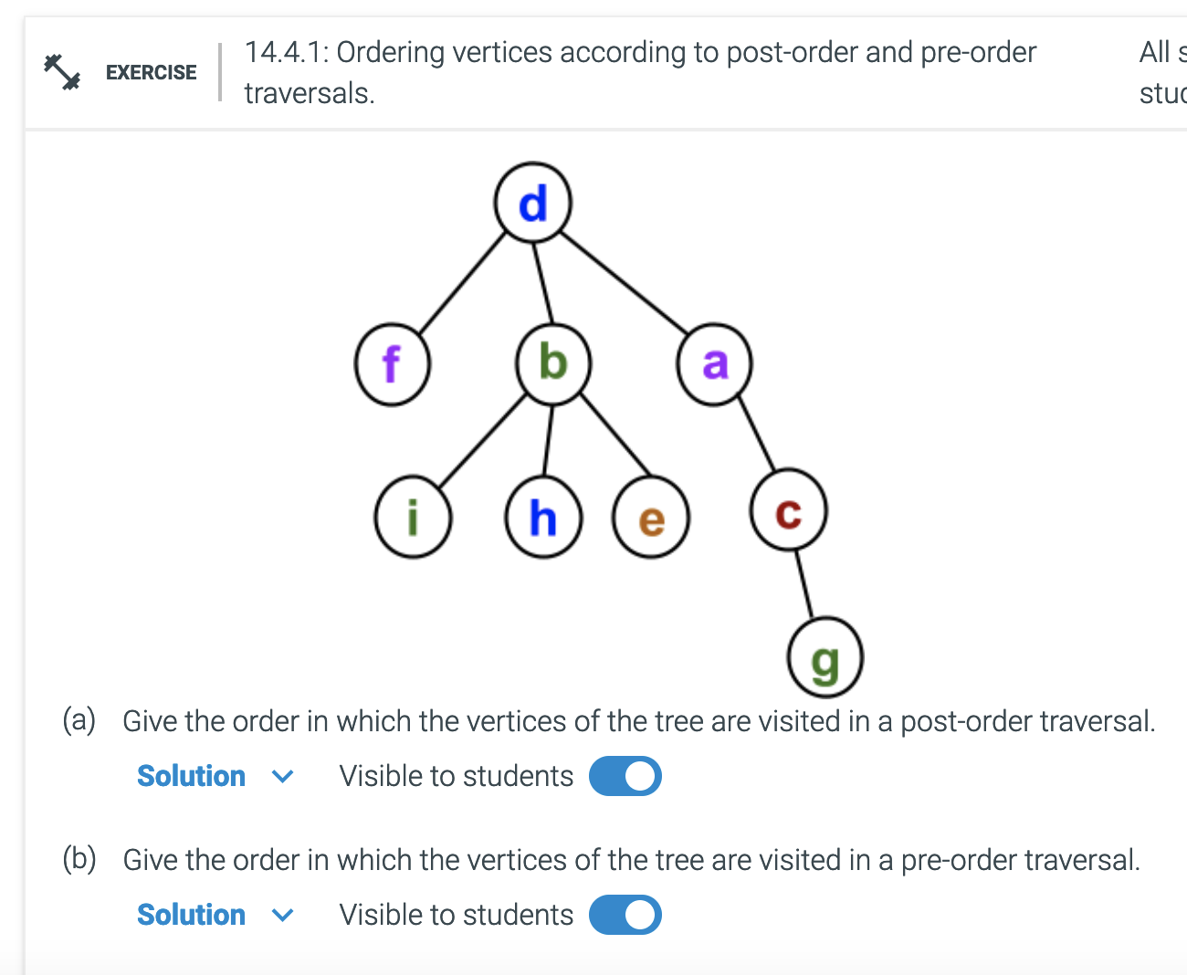
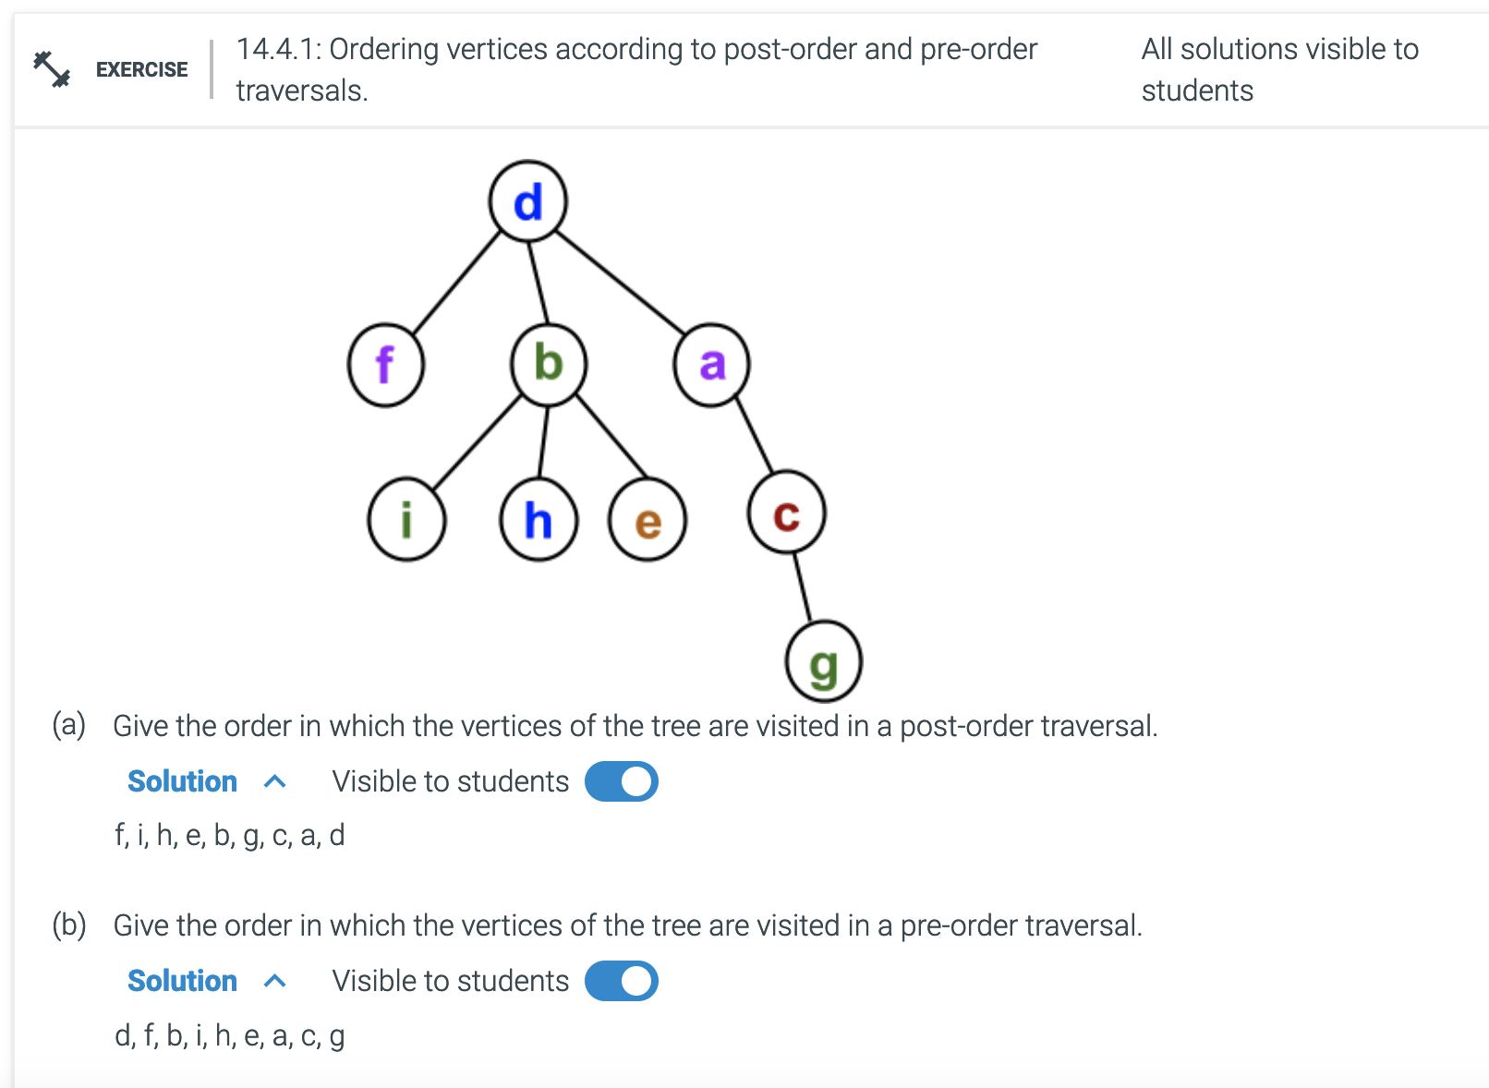
Additional Exercises:
14.4.1
14.4.2

Slide 50
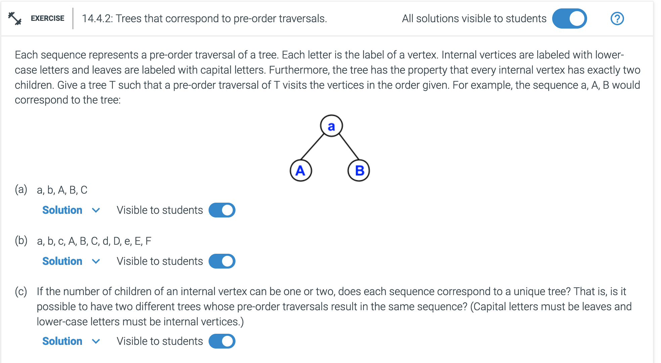
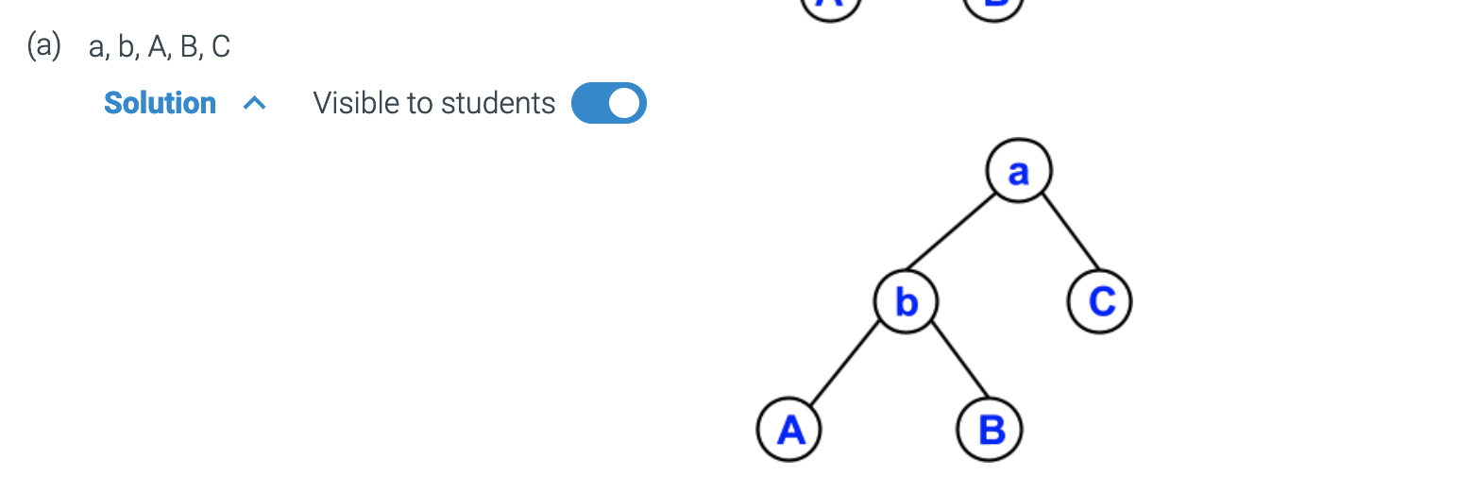
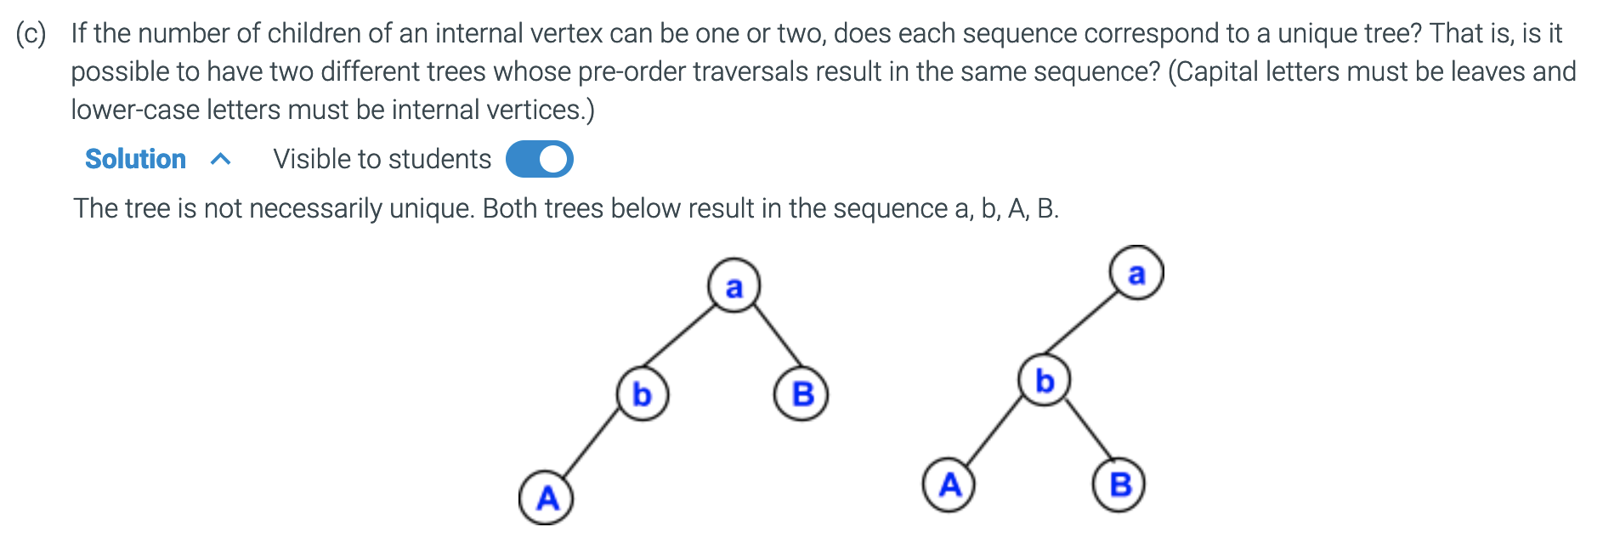
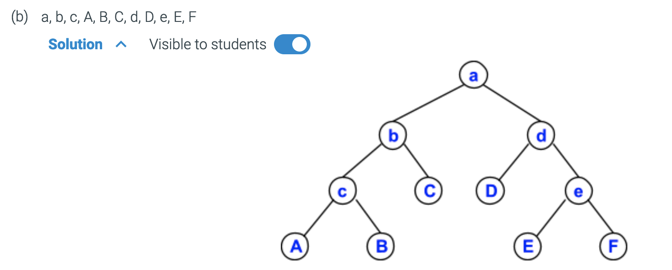
Additional Exercises:
14.4.1
14.4.2

Slide 52
Basic
Huffman Trees
Building a tree
Tree Traversal
Searching a tree
Spanning Tree
Changing Graphs to trees
Depth vs Breadth
Minimum Spanning Tree

Slide 53
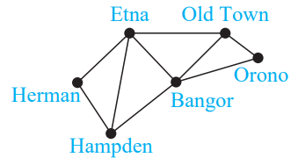
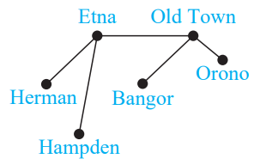
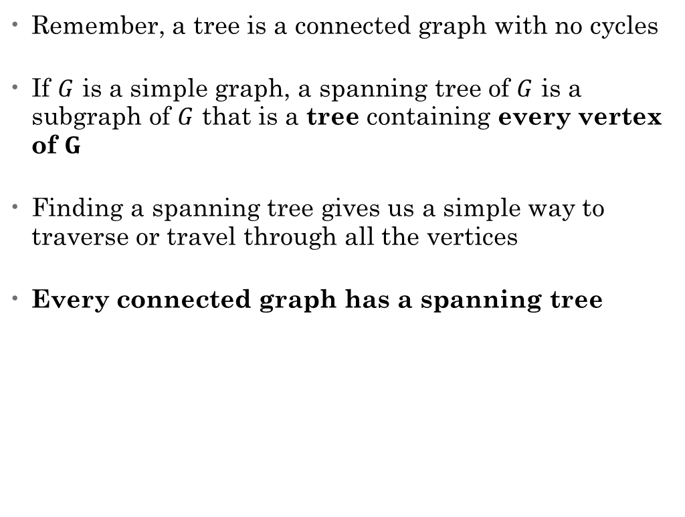
Spanning Trees
Remember, a tree is a connected graph with no cycles
If $G$ is a simple graph, a spanning tree of $G$ is a subgraph of $G$ that is a tree containing every vertex of $G$
Finding a spanning tree gives us a simple way to traverse or travel through all the vertices
Every connected graph has a spanning tree
Rosen, Kenneth. Discrete Mathematics and Its Applications, 7th Edition. McGraw-Hill, 2012

Slide 54
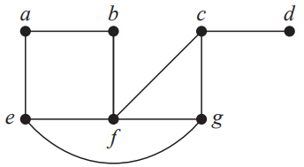
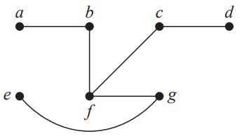
Finding a Spanning Tree
Remove edges that create a cycle
Rosen, Kenneth. Discrete Mathematics and Its Applications, 7th Edition. McGraw-Hill, 2012

Slide 55
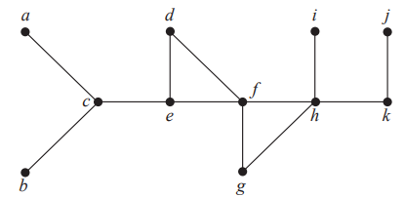
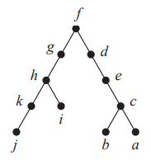

Depth-First Search
Start with arbitrary vertex.
Build a path by successively visiting each edge incident with that vertex that has not already been visited.
Continue until no longer possible. Backtrack to the previous vertex and repeat process.
Let's start at $f$:

Slide 56
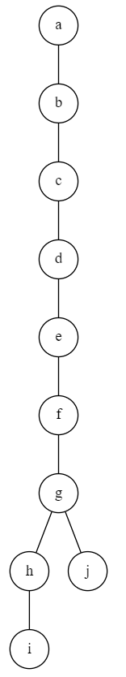
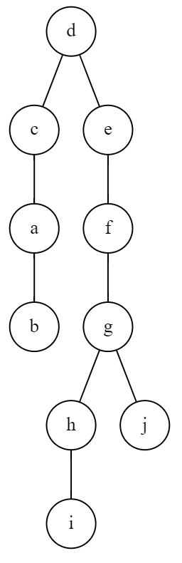
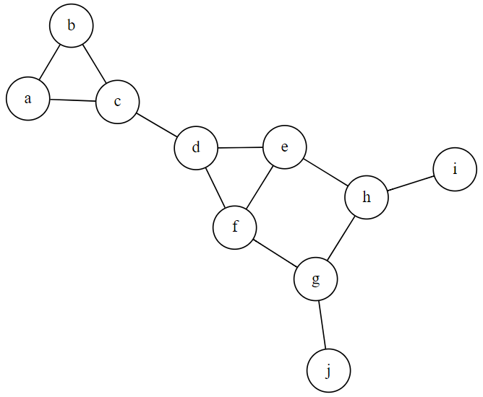
Practice:
Use depth-first search to find a spanning tree for this graph, starting at "d"
Order starting at "d":
d,c,a,b,e,f,g,h,i,j
Order starting at "a":
a,b,c,d,e,f,g,h,i,j

Slide 57
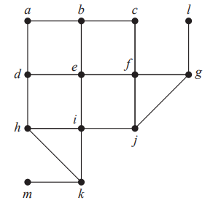


Breadth-first Search
Choose a vertex and add it to the new tree.
Add all edges incident with that vertex. Then for each of those, add each edge incident. Continue until all edges have been added.
Let's start at $e$:

Slide 58


Practice:
Use breadth-first search to find a spanning tree for this graph, starting at "d"
Order starting at "d":
d,c,e,f,a,b,h,g,i,j
Order starting at "a":
a,b,c,d,e,f,h,g,i,j

Slide 59
Applications for BFS & DFS
What would BFS & DFS look like for these scenarios?
Family "tree"
Finding names
Learning about ancestors
Finding a path through a maze
Web crawler
Can you think of any other applications?

Slide 60


Additional Exercises:
14.5.1

Slide 61


Trees
Cont…

Slide 62
Filesystem
Filesystem hierarchy can be represented as a tree.
What else?

Slide 63





Slide 64
Basic
Huffman Trees
Building a tree
Tree Traversal
Searching a tree – Pre-, In-, Post-
Spanning Tree
Changing Graphs to Trees
Depth vs Breadth
Minimum Spanning Tree

Slide 65

Representing Mathematical Expressions
Prefix notation – The operator comes first
$∗ + 1 2 ∗ 5 6$
As a list:
$[∗,[+, 1, 2],[∗,5,6]]$
In infix notation:
$(1+2) ∗ (5 ∗ 6)$ = 90
*
+
*
1
2
5
6

Slide 66

Representing Mathematical Expressions
Draw the tree and evaluate this expression:
$[ /, [∗, 12, 4], 2]$
In infix notation:
$(12 ∗4)/2=24$
/
*
2
12
4

Slide 67


Minimum Spanning Tree
Some graphs are represented with a cost or weight for each edge.
We would like to figure out how to visit every vertex in the graph while minimizing the total cost.
What are some problems this would help to solve?
The minimum spanning tree of a graph $G$ is a spanning tree whose weight is no larger than any other spanning tree of $G$.
There can be more than one minimum spanning tree for a given graph.

Slide 69

Prim's Algorithm
Created in 1957 by Robert Prim.
1. Pick a starting vertex in the graph and add it to the tree.
2. For each vertex in the tree, find an edge in the graph with the smallest cost that leads to a vertex not yet in the tree. Add the new vertex to the tree.
3. Continue with step 2 until every vertex in the graph has been added to the tree.

Slide 70
Prim's Algorithm
1. Pick a starting vertex in the graph and add it to the tree.
2. For each vertex in the tree, find an edge in the graph with the smallest cost that leads to a vertex not yet in the tree. Add the new vertex to the tree.
3. Continue with step 2 until every vertex in the graph has been added to the tree.

Slide 71

Prim's Algorithm
Total cost: 17
Order:
(a,b), (b,c), (a,e), (e,f),
(f,g), (g,h), (c,d)

Slide 72





Additional Exercises:
14.6.1
14.6.2

Slide 73



Additional Exercises:
14.6.1
14.6.2

Slide 74
Learn about finding paths in graphs
https://tinyurl.com/cse280-w12

Slide 75

Binary Search Tree
Allows us to store a list of items in sorted order
Fast searching
Key at each node (k)
All keys in the left subtree are less than k
All keys in the right subtree are greater than k
The search time is cut in half after each step if the tree is balanced

Slide 76


BST Example
How many items do we have to look at to find the number 1 in this list:
[5, 2, 3, 6, 8, 10, 7, 1]
Using Linear search
Takes $n=8$ comparisions
Using Binary Search
Let's create a BST:
http://btv.melezinek.cz/binary-search-tree.html
What is the search cost to find 1?
3 comparisons

Slide 77

BST Practice
Create a BST for the names of the writers of the New Testament, using alphabetical order:
matthew mark luke john peter james paul jude
What is the height $h$ of this tree?
What is the search cost to find "james"?
Matthew
Mark
Peter
Luke
Paul
John
James
Jude

Slide 78

BST Practice
Create a BST for the names of the writes of the New Testament, using alphabetical order:
matthew mark luke john peter james paul jude
What is the height $h$ of this tree?
Is this tree balanced?
Full?
Complete?
Perfect?
Matthew
Mark
Peter
Balanced: All leaves are within one level
Full: Every node has 2 or 0 links
Complete: Nodes with only one leaf have that leaf to the left
Perfect: Every node has two children except the leaf nodes. All nodes are at the same level.
Luke
Paul
John
James
Jude

Slide 79
Which Tree?
To the right, is a representation of a tree. It follows a certain set of rules. Which of these representations is the binary tree rooted at m?
[m, [a, [b, d], [f], [q, [p, [s, r, z]]]]]
[m, [b, d, a, f], [q, p, s, r, z]]
[m, [b, a, [d, f]],[q, p, [s, r, z]]]
[m, [q, [p, [r, [s, z]]]], [f, [a, d, b]]]

Slide 80
Which Tree?
To the right, is a representation of a tree. It follows a certain set of rules. Which of these representations is the binary tree rooted at m?
[m, [a, [b, d], [f], [q, [p, [s, r, z]#s]#p]#q ]#a ]#m – node
[m, [b, d, a, f], [q, p, s, r, z]]#3 vs 4/5
[m, [b, a, [d, f]], [q, p, [s, r, z]]] [C, L, R]
[m, [q, [p, [r, [s, z]]]], [f, [a, d, b]]] -node

Slide 81




Binary Search Trees Cost
7.21
The number of comparisons to find a given node in a binary search tree is the cost.
We can calculate an average or expected search cost by averaging the costs of all the nodes in a tree.
7.22.1
There are 11 total words, so we divide the total cost by 11 to get an average cost
7.22.2

Slide 82


Weighted Binary Search Trees
We can use weighted costs to represent the likelihood that a given node will be searched for.
Minimizing the expected search cost is the Optimal BST Problem.
Given the weights: $[1:0.4, 2:0.3, 3:0.2, 4:0.1]$
What is the expected search cost for this tree?
Cost to find 2 = 1 comparison * 0.3 weight = 0.3
Cost to find 1 = 2 comparisons * 0.4 weight = 0.8
Cost to find 3 = 2 comparisons * 0.2 weight = 0.4
Cost to find 4 = 3 comparisons * 0.1 weight = 0.3
Expected Search Cost = $(1∗0.3)+(2∗0.4) + (2∗0.2) + (3∗0.1) = 1.8$
Note: A different BST for these nodes would produce a different Expected Search Cost

Slide 83
Begin working on Homework 12 with your peers.

Slide 84
Printing Trees with Python
Example

Slide 85
How Many Levels
What is the height of a balanced BST holding 25 nodes?
1
2
3
4
5

Slide 86


How Many Levels
What is the height of a balanced BST holding 25 nodes?
1
2
3
4
5
How many leaves?
$2n −1=25$
$n=13$ leaves
What is $h$?
$2^{h}≥13$
$h≥\log_{2}{13}$
$h=ceil\left(\log_{2}{13}\right)$
$h=4$
A full binary tree with $n$ leaves has $2n−1$ nodes.
If the height of a tree is $h$, then it has at most $m^{h}$ leaves (for a binary tree, $2^{h}$)

Slide 87
Review Homework 12
12.6
12.7
12.8
Any others you had questions on

